Slide 1



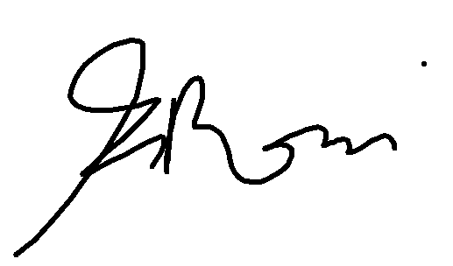
ELETTROZEN SRL
Certificato Partner EcoXpertTM
IT-Digital Energy-EcoXpert-Certified
Saul Fava
VP Digital Energy
Schneider Electric
Francesco Rossi
Digital Energy Innovation Manager
Schneider Electric
2026

